Slide 1

skyline plaza collapse
Amirpooya hadizadeh
Prof.ahmadi

Slide 2

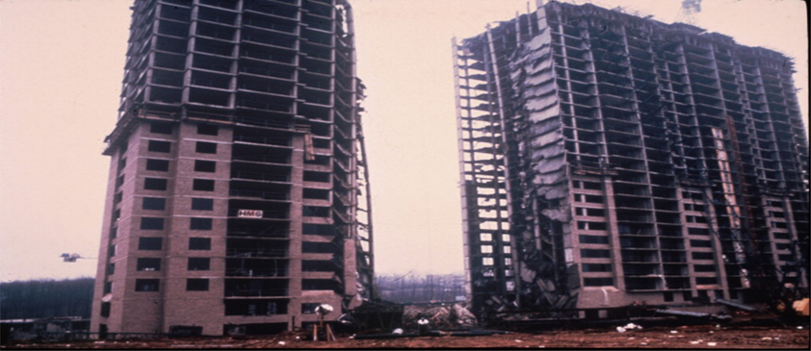
INTRO
Skyline Plaza was a large complex located in Bailey's Crossroads, Virginia which included eight apartment buildings, six office buildings, a hotel, and a shopping center. In the midst of construction on March 2, 1973, one apartment building (A-4) and the parking garage adjoining it collapsed. The incident occurred at around 2:30 in the afternoon and resulted in the death of 14 construction workers and the injury of 34 others.
The reconstruction of the Skyline Plaza began in 1974 and was completed in 1976. The rebuilt apartment building was renamed Skyline House and is still standing today

Slide 3

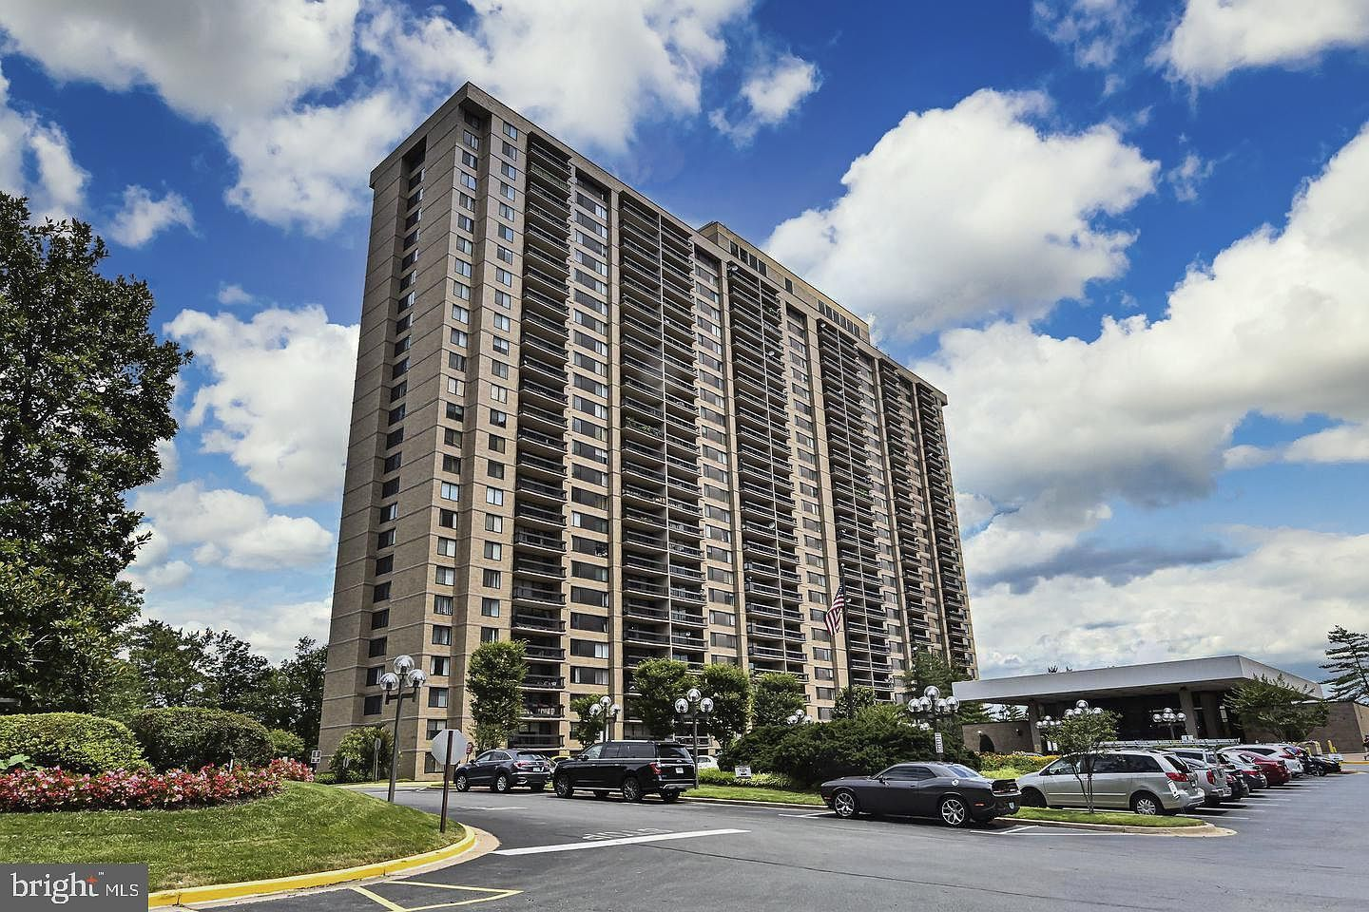
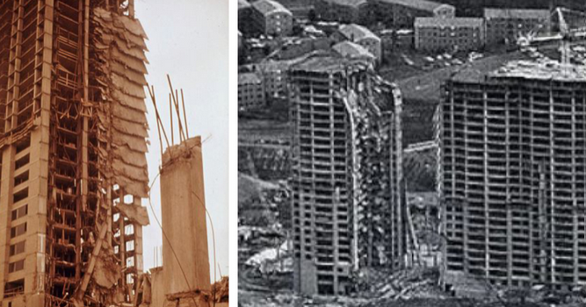

Slide 4
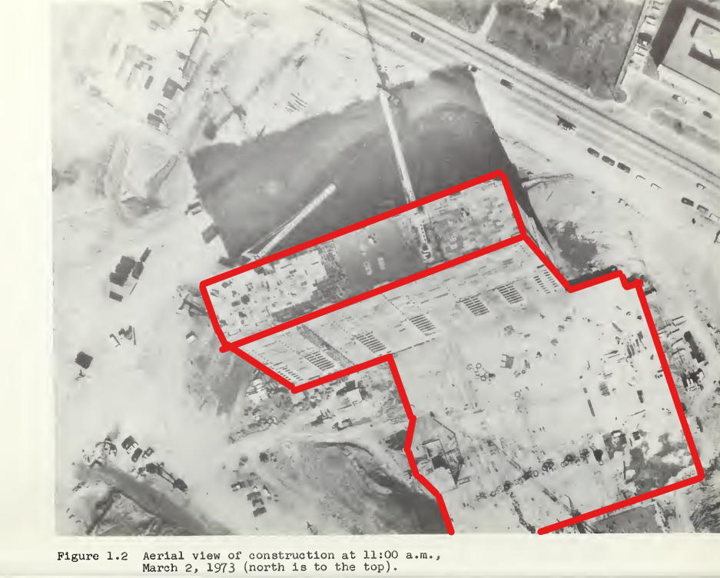
This photo was taken approximately
3 hours before collapse.

Slide 5
Building A-4 was of reinforced concrete flat plate construction supported on a 4-ft thick foundation mat. The A- 4 completed structure was to have 26 stories of apartments, plus a penthouse and a four-story basement.
The specified column concrete strength varied; it was 5000 psi from the foundation mat to the 7th floor, 4000 psi from the 7th to the 17th floor, and 3000 psi above the 17th floor. The slabs used lightweight aggregate (coarse aggregate only) concrete with a specified strength of 3000 psi.
The collapse started in building A-4 and progressed vertically to the ground and horizontally to include the entire parking garage.

Slide 6
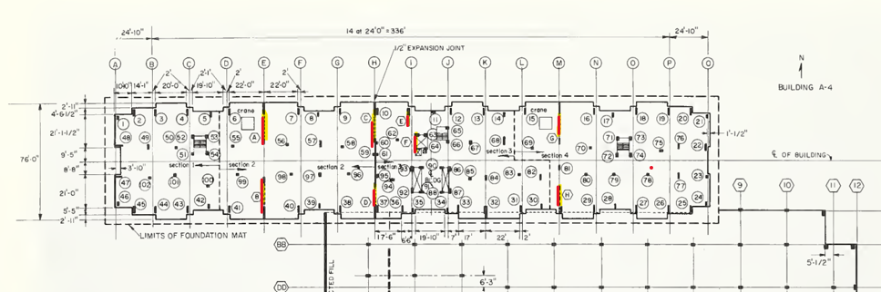
There are eight shear walls in the structure. These are designated as A through H in the drawing.

Slide 7
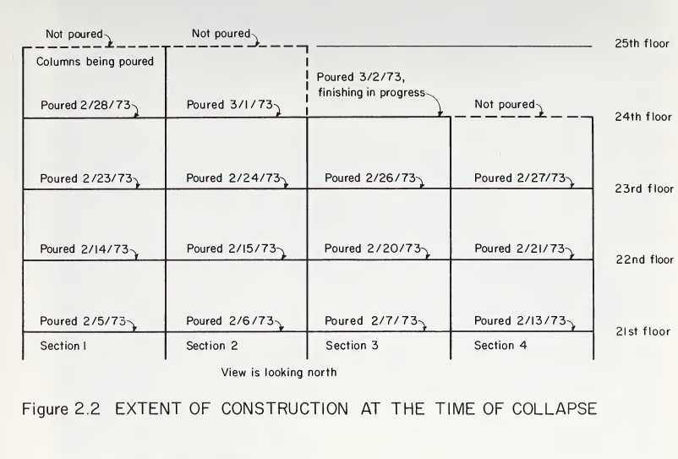
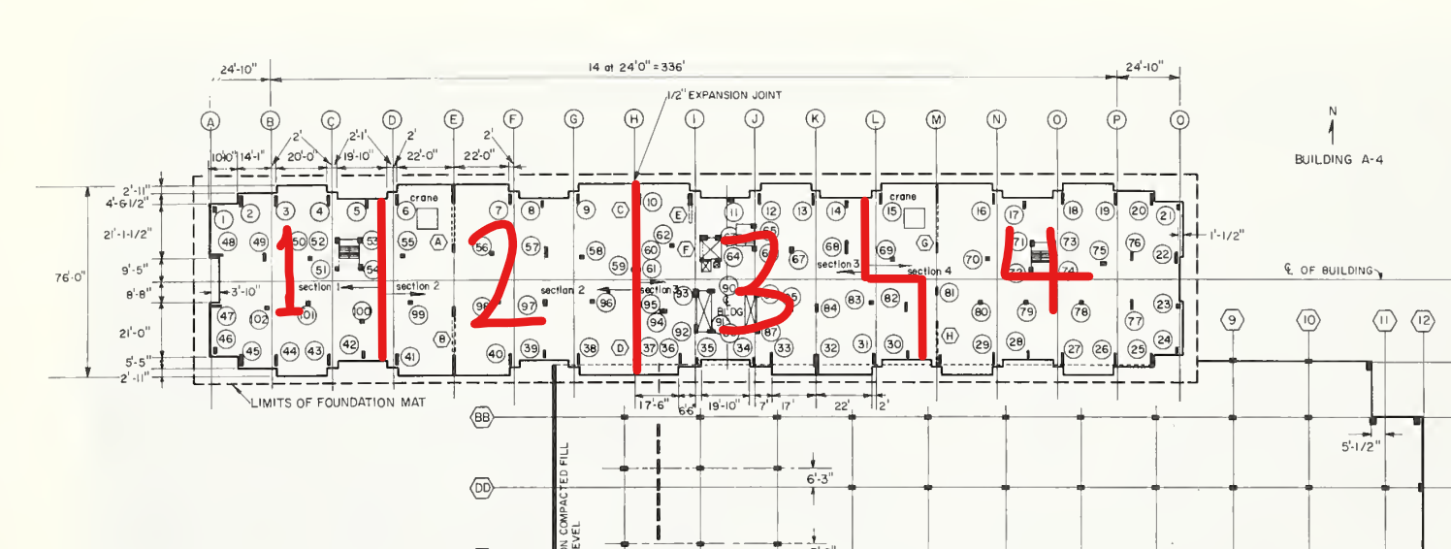
A typical floor of the building was poured in four sections; the progress of construction at the time of the collapse is shown in figure 2.2

Slide 8
Area of collapse
The collapse extended between shear wall H and column 33 on the south face, a distance of about 65 ft .On the north face the collapse extended between columns 12 and 17, a distance of about 104 ft.
On the night of March 4 the remaining portion of the building to the east of the failure zone was completely demolished.

Slide 9
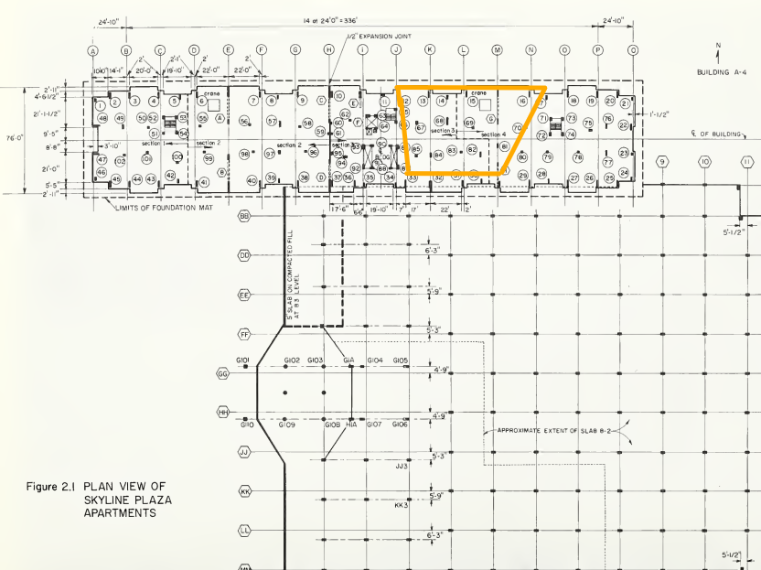
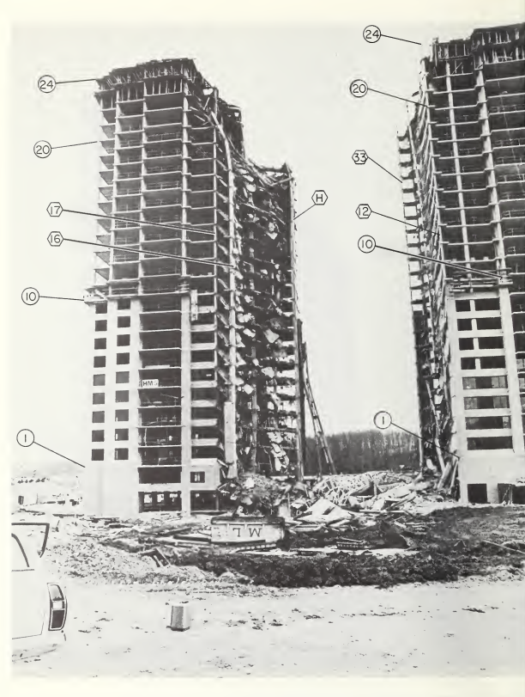

Slide 10
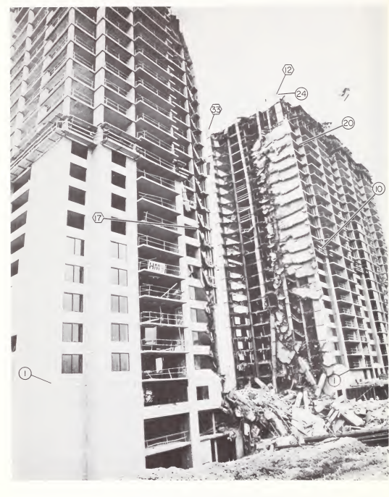
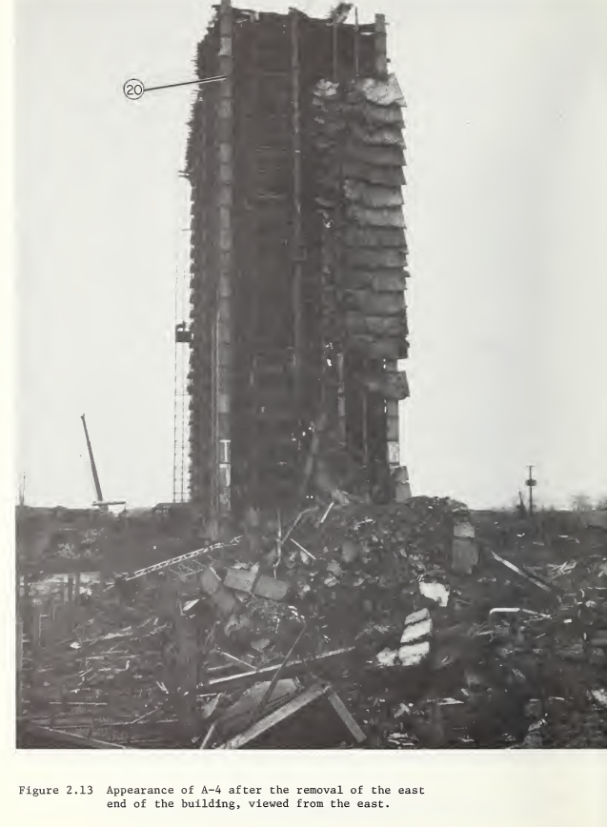

Slide 11
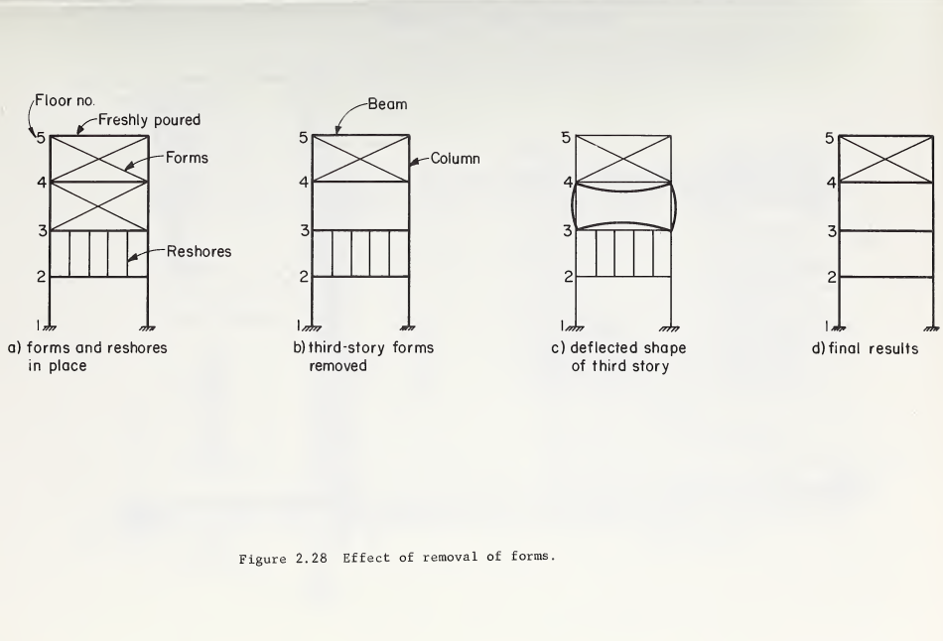
The net result of the removal of forms causing an upward deflection of the 3rd floor could quite conceivably cause the 2nd story reshores to fall out with the final result shown in figure 2.28.

Slide 12
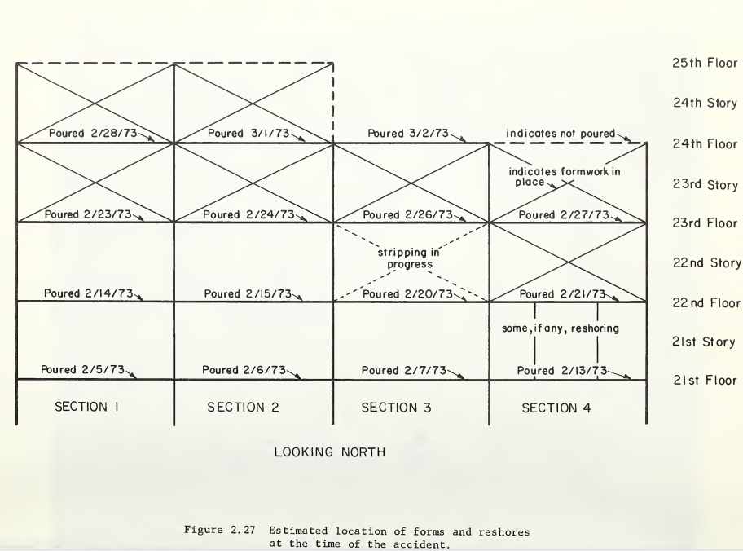
Based on the above simplified analogy plus previously mentioned photographs it is concluded that form stripping was in progress in the 3rd section of the 22nd story.

Slide 13
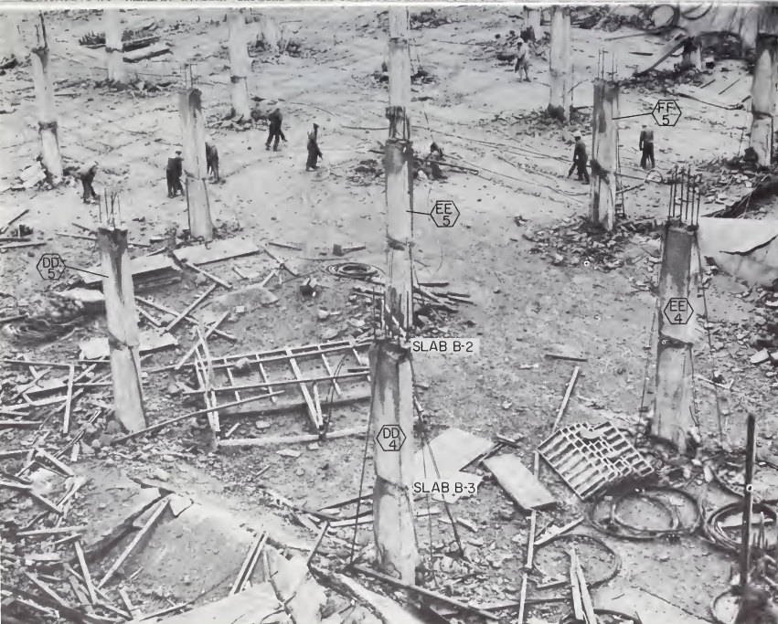
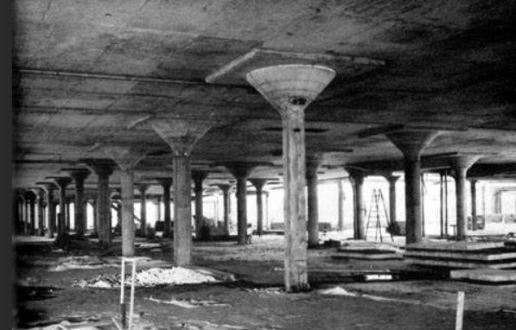
Note: the virtual lack of shear cones at the slab levels on most of the columns in that figure.

Slide 14
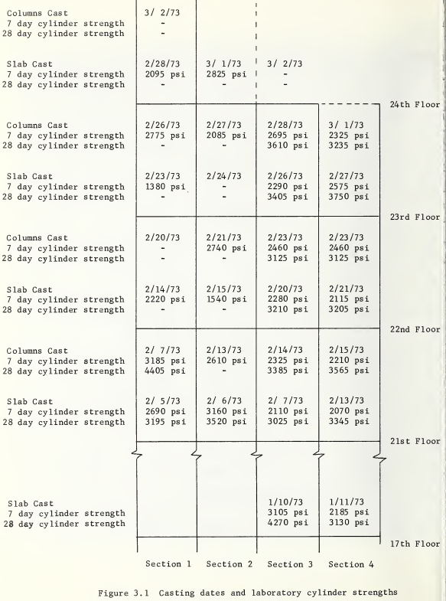
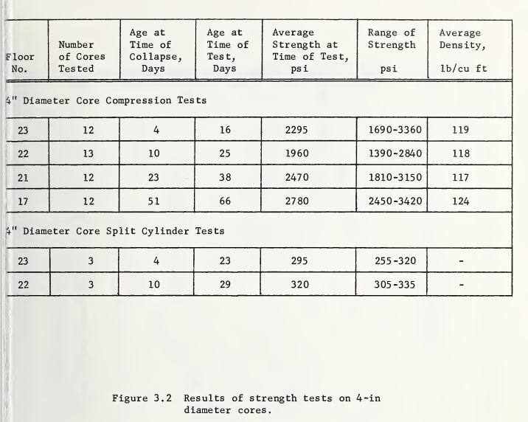


Concrete resistance
The results of standard cylinder tests, however, do not reflect the effect of field curing conditions or the strength of the concrete in place.
Why?

Slide 15
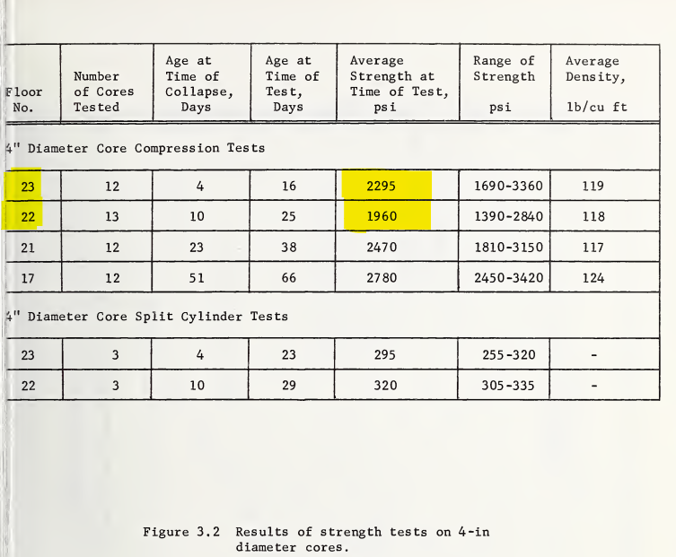
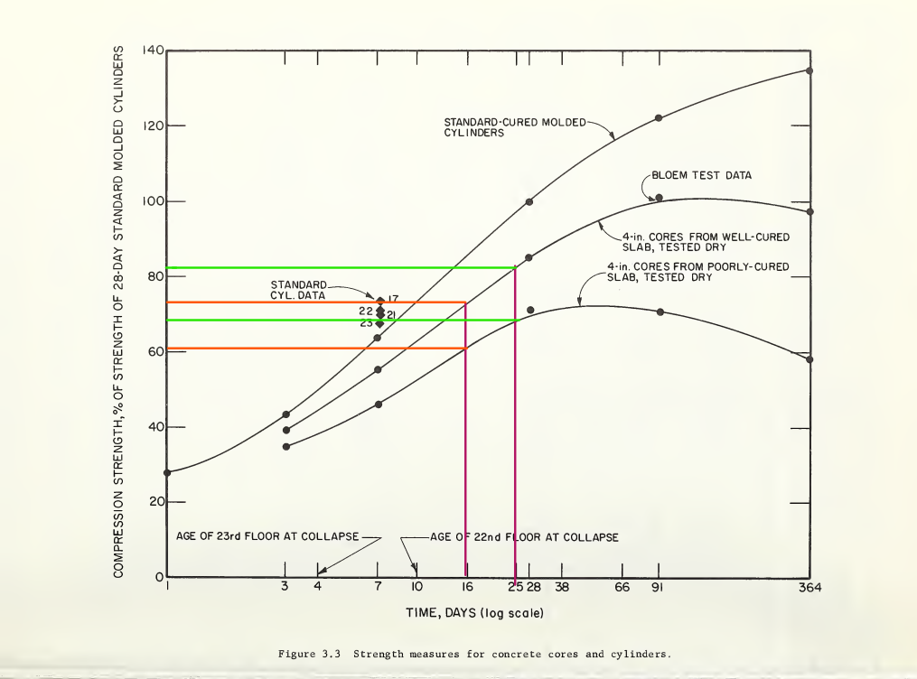





Slide 17
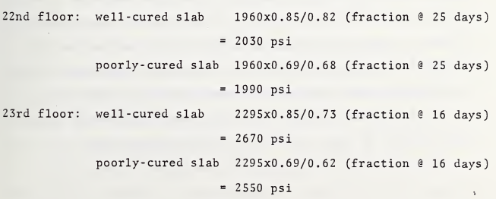

Slide 18
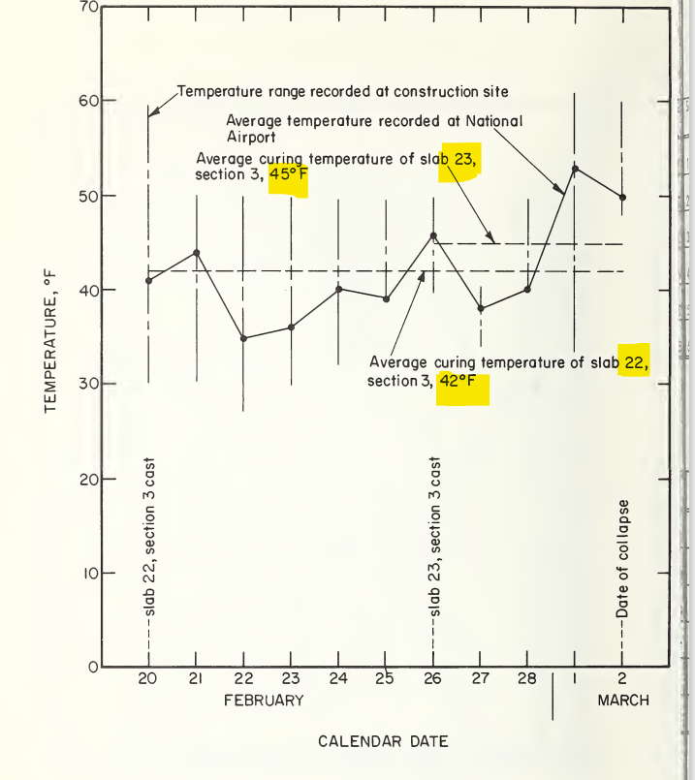
temperature changes

Slide 19
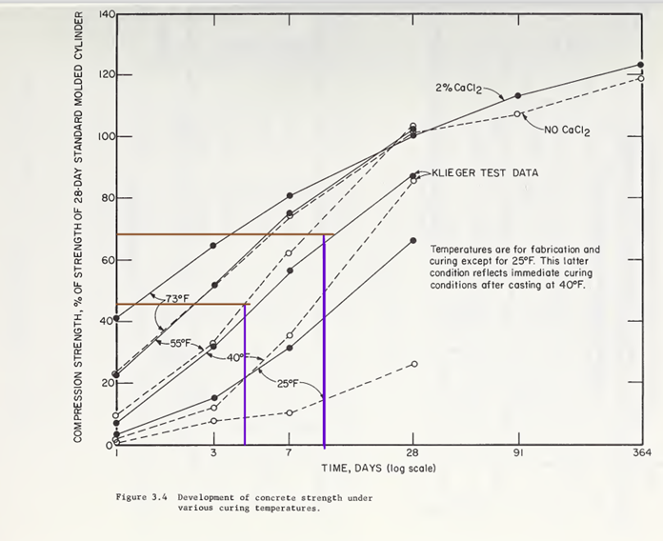

Slide 20
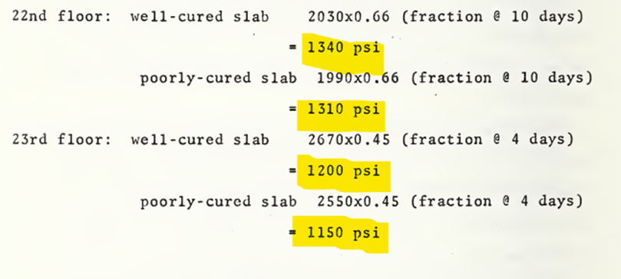

Slide 21
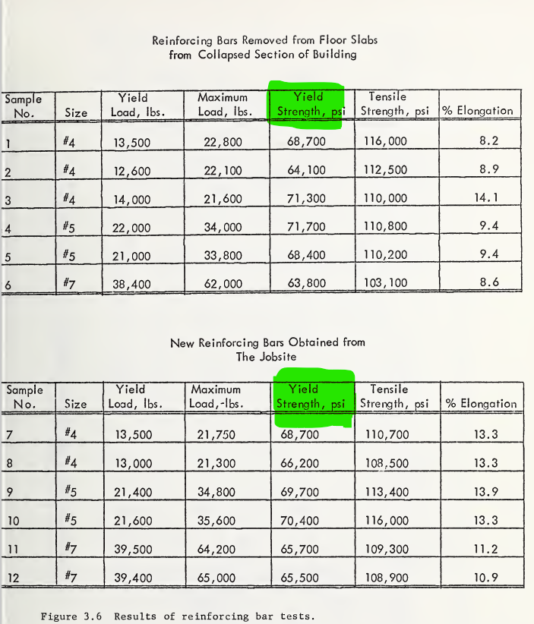
Reinforcing steel
The structural engineer generally called for reinforcing steel with a 60,000 psi yield point and meeting the requirements of ASTM A-615. The steel tested satisfies the requirements of that specification.

Slide 22
Case1:All forms on the 22nd story were removed before the collapse. This essentially means that the 23rd floor slab carried its own weight, the weight of the 24th floor slab, and the weight of the forms underneath the 24th floor slab.
Case2:assumed the concrete to have attained its full 28-day design strength of 3000 psi.
Case3:Only some of the forms on the 22nd story were removed which results in both the 22nd and 23rd floor slabs sharing the load from above.

Slide 23
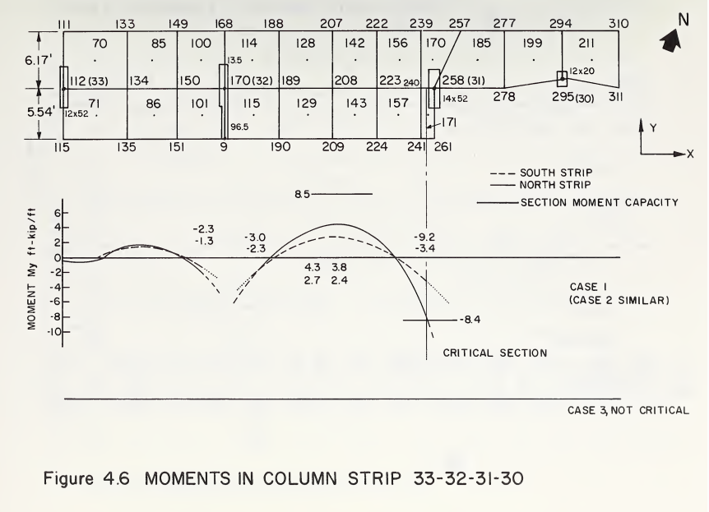
Moment control
negative moment at the critical section near column 31 (node 258) was about 9.2 ft-kips/ft. The moment capacity of the slab at this section, determined on the basis of reinforcement details in the contract drawings, was found to be about 8.4 ft -kips/ft.
indicating that the flexural capacity of the section was exceeded by about 10 percent.

Slide 24
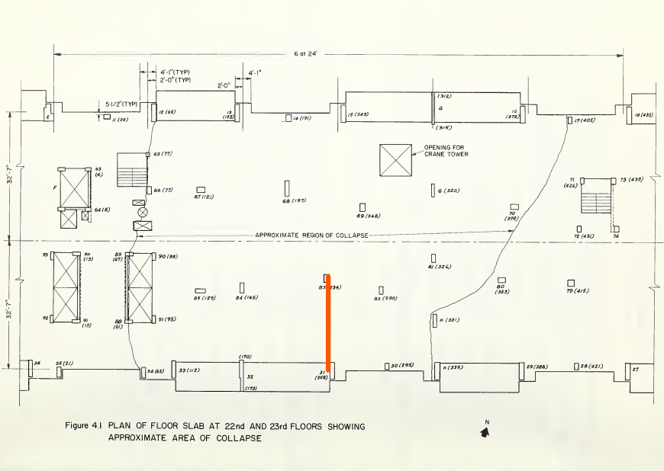
Thus it is estimated that yielding occurred in the slab at column 31 and yielding propagated toward column 83.
However, this local yielding is not sufficient to cause a collapse mechanism of the 23rd story floor slab. In fact, a flat slab construction of the type used in Skyline Plaza building is generally recognized to have considerably greater moment capacity than the capacity at which the first local yielding occurs because of its inherent ability to redistribute peak moments to neighboring regions through the mechanism of yielding.
it is concluded that the initial mode of failure of either the 22rd or the 23rd floor slab was not flexural.

Slide 25
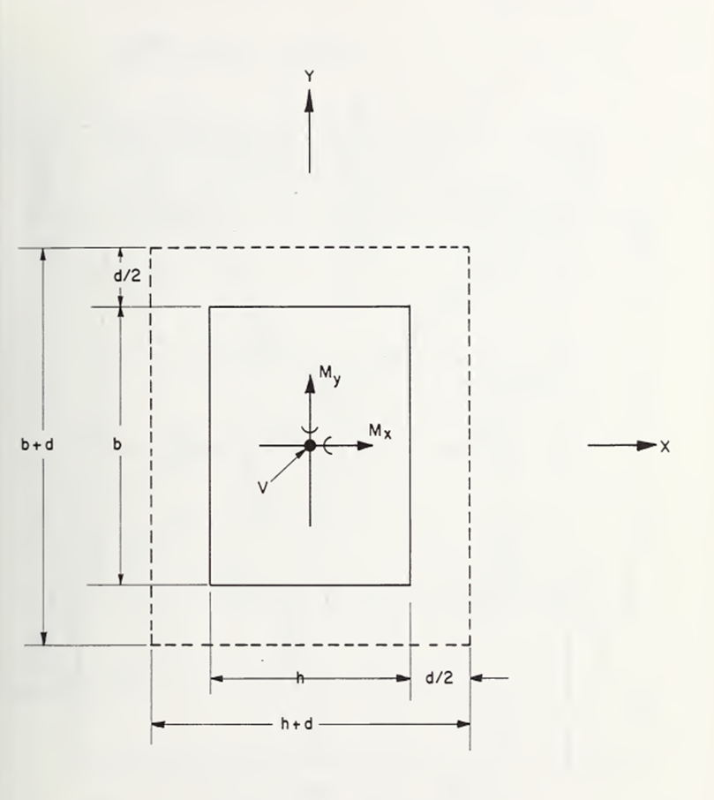
Shear control

Slide 26
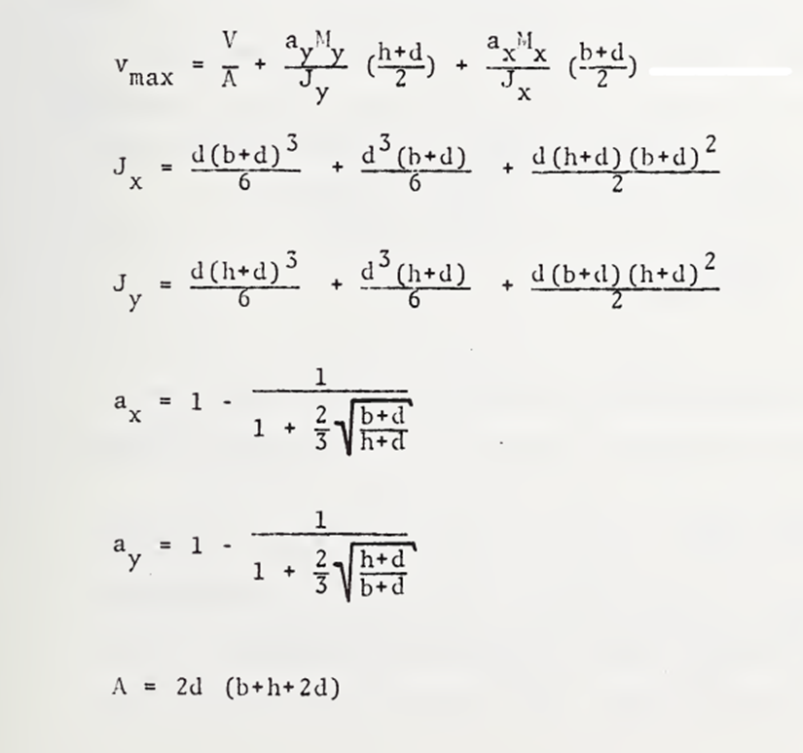
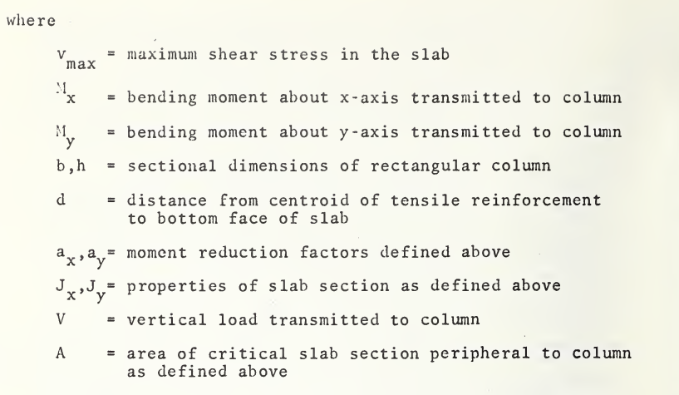
Shear control

Slide 27
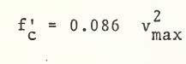
According to ACI 318-71 , V(max) must be lower than 3.4√fc .
Critical status

Slide 28
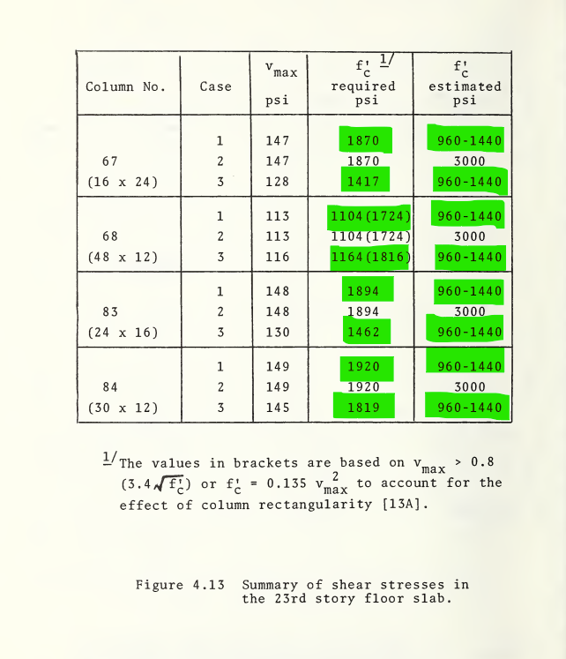
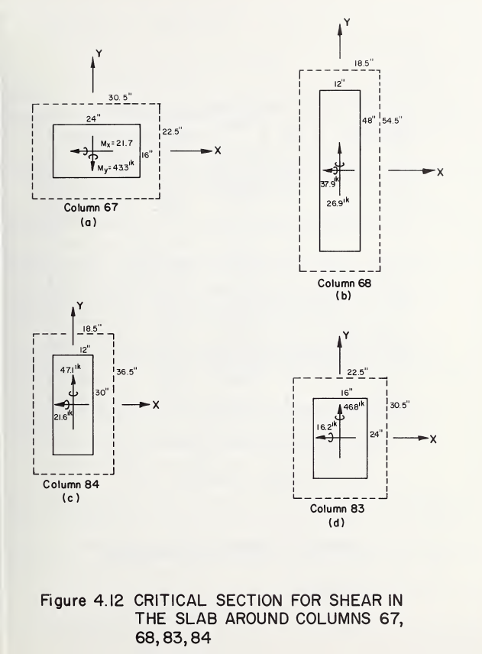
Critical columns

Slide 29
cause
Upon examination of all the probable conditions prior to the collapse, it is concluded that the initial shear mode of failure of the 23nd story floor slab resulting from partial or complete removal of shoring prior to the incident was a major contributing factor to the collapse.

Slide 30
cause
The most likely mode of collapse has been determined to be a shear failure around columns 67, 68, 83, or 84. The premature removal of forms supporting the 23rd story slab when the concrete of that slab had a relatively low strength produced shear stresses that were in excess of the concrete capacity at the time of the incident . The three-dimensional finite element analyses have shown the slab to be overstressed in flexure in only a few local regions. The capacity of flat slabs to redistribute moments is well known and thus local flexural yielding should not have led to failure.

Slide 31
Lesson learned
Based upon the analysis of case II it is concluded that this collapse could have been prevented if the shoring remained until the concrete reached its full design strength. (Leyendecker 1977)

Slide 32
Lesson learned
The tragedy of Skyline Plaza taught the building industry some important lessons.
1. Redundancy within structural design is essential to prevent progressive collapse. (Feld 1997)
2. Construction loads must always be considered during design. There are many instances when these loads will control the design. (Ross 1984)
3. Formwork and shoring needs to be detailed by the contractor.
4. Concrete testing must be performed before the removal of shoring.
5. Inspections must verify that the contractor is properly shoring floors above and that poured concrete is meeting its design strength. (Kaminetzky 1991)

Slide 33

reference
1.NBSIR 73-222 Investigation of the Skyline Plaza Collapse in Fairfax County, Virginia E. V. Leyendecker and S. G. Fattal
2.NBS BUILDING SCIENCE SERIES 94 U.S. DEPARTMENT OF COMMERCE / National Bureau of Standards
3. Skyline Plaza - Bailey's Crossroads (March 2, 1973) Stephen A. Perkins, BAE/MAE, Penn State, 2009
4.https://www.youtube.com/watch?v=98Rd1v1pOrQ&pp=ygUyc2t5bGluZSBwbGF 6YSBjb2xsYXBzZSBpbiBmYWlyZmF4IGNvdW50eSwgdmlyZ2luaWE%3D

Slide 34
THANK YOU

